Slide 1
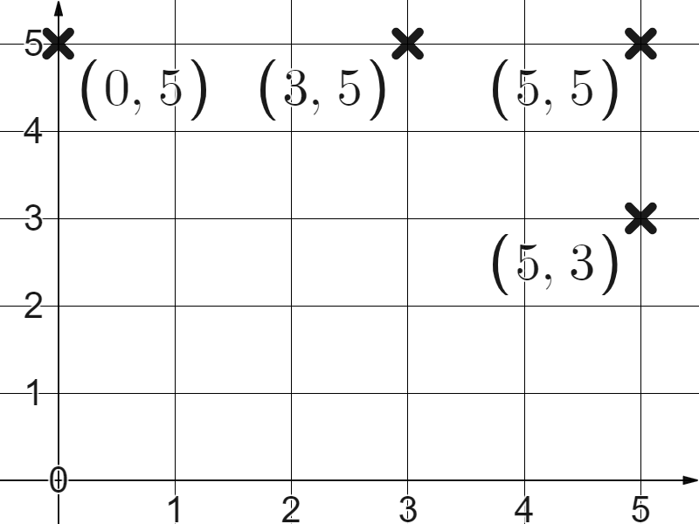
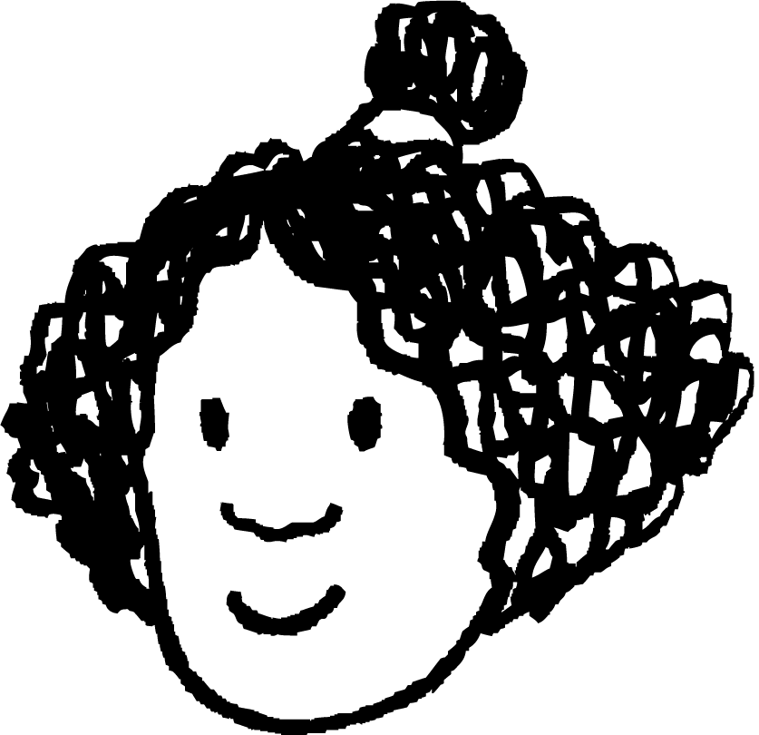
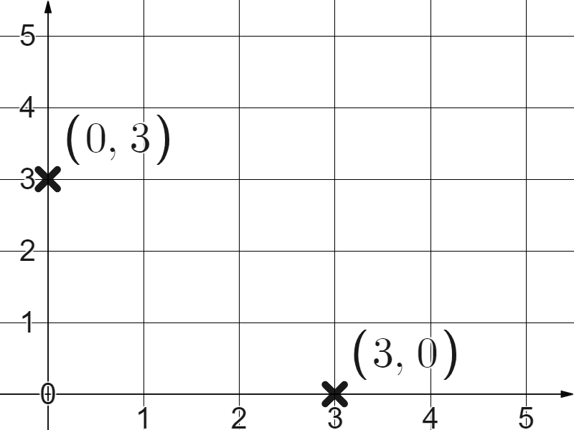
Checking understanding of plotting coordinates
Task A: Plotting coordinates in the first quadrant
origin
1) The coordinate (0,0) where the and axes cross is called the .
2) Plot these coordinates and label them:
(3,5)
(5,3)
(5,5)
(0,5)
3) Izzy plots the coordinate (3,0).
Write a sentence to explain her error.
Your sentence might have read, ‘(3,0) is three in the positive direction, then zero in the direction from the origin. Izzy did it the other way round’.

Slide 2
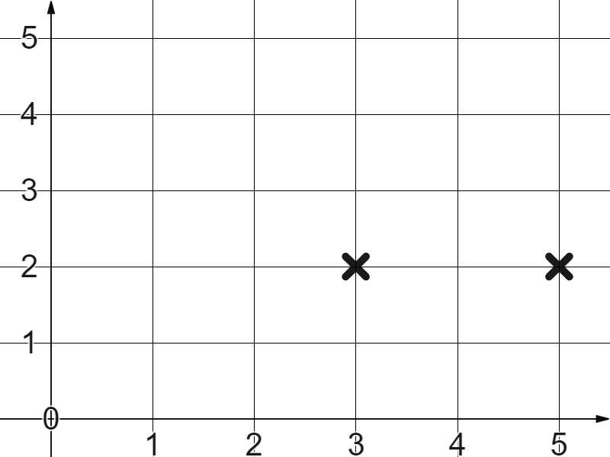
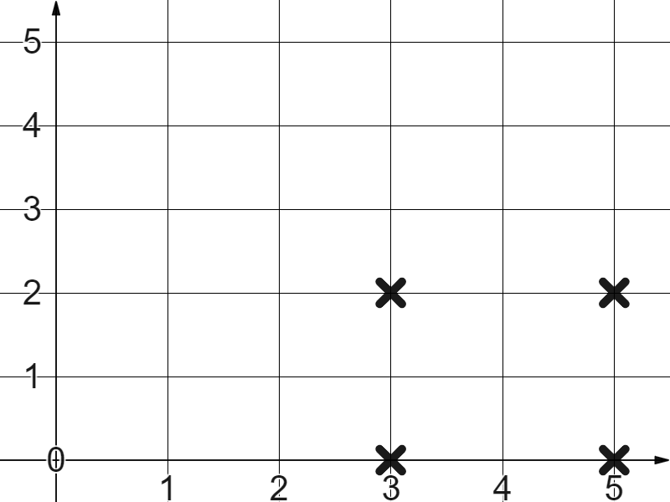
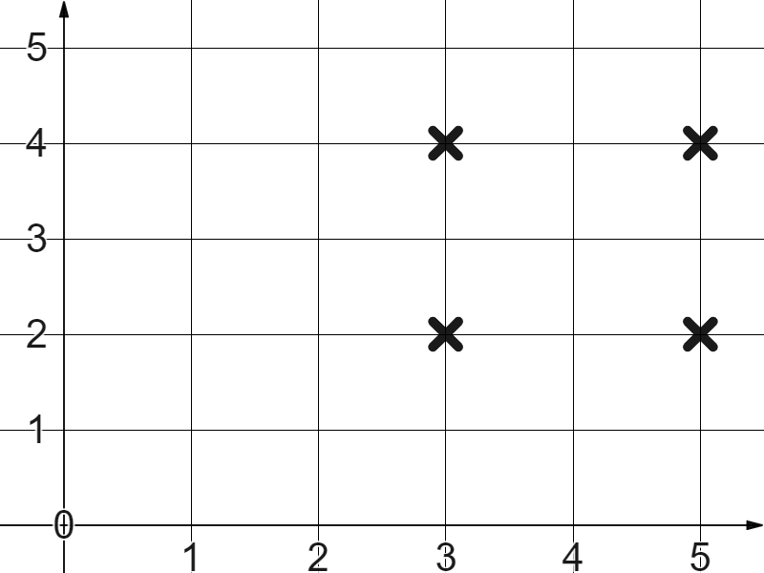
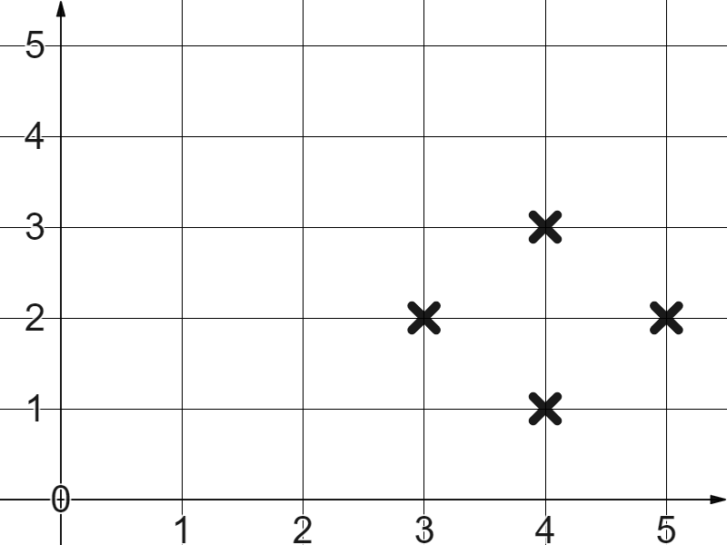
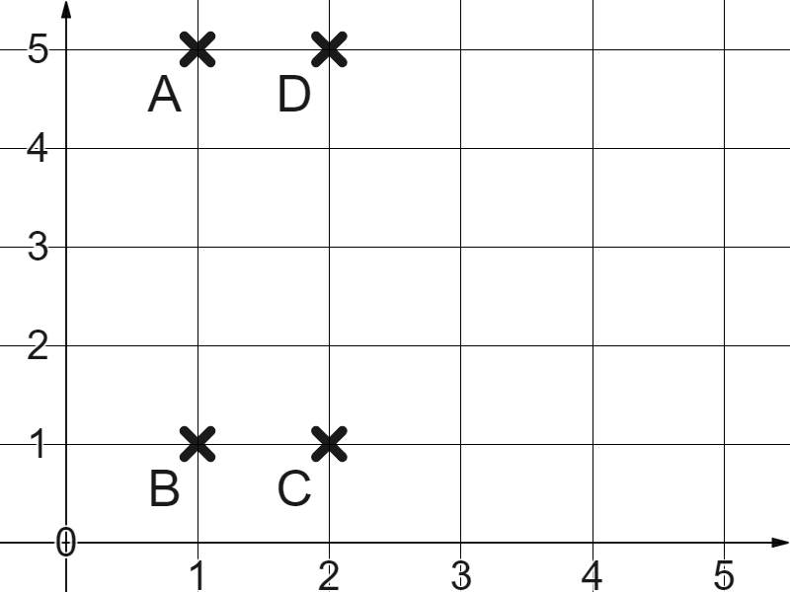
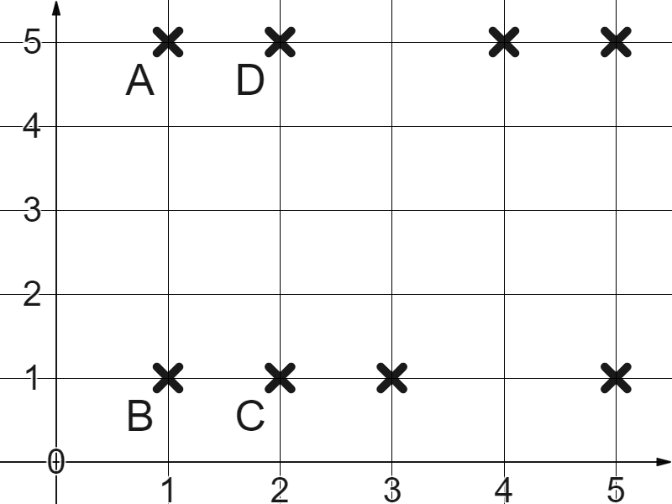
Checking understanding of plotting coordinates
Task B: Using coordinates to plot shapes
1) The first two coordinates are (3,2) and (5,2)
Which other coordinate pairs would form a square?
(3,0) and (5,0) make a square.
(3,4) and (5,4) make a square.
(4,1) and (4,3) make a square.
Task C: Translating shapes
1) Why will the below not create a translation of rectangle ABCD?
A (1,5)
B (1,1)
C (2,1)
D(2,5)
(4,5)
(3,1)
(5,1)
(5,5)
The four points did not all follow the same rule.
Mathematics in Education and Industry.
v2.2

